Slide 1
Elliptical Pattern Identification
Rodney McCoy, Riley Doyle, and Luis Lopez

Slide 2
Overview
Value Proposition
Background
Project Objective
Front End Design
Building the Front End
Tenets of Software Engineering
File Management
Graphical User Interface (GUI)
Documentation
Back End Design
Code Base Reconstruction
The Algorithm
Review

Slide 3
Value Proposition
Incorporate Atmospheric Gravity Waves (AGWs) into climatological models
Increase model reliability
Improve course of action taken to protect the environment

Slide 4
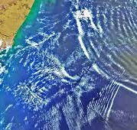
Background
In 2020 students gathered flight data from weather balloons in Chile during an eclipse
By analyzing the flight data, we can locate Atmospheric Gravity Waves

Slide 5
Project Objective
Design a python program to autonomously identify elliptical structures in flight profiles
Handle multiple large datasets
Apply program nationwide in future campaigns

Slide 6
Project Objective
Continuation of a previous project
Previous python script
Difficult to use
Buggy file input and output
Labor-intensive ellipse detection
Chem-E related functionality works very well

Slide 7
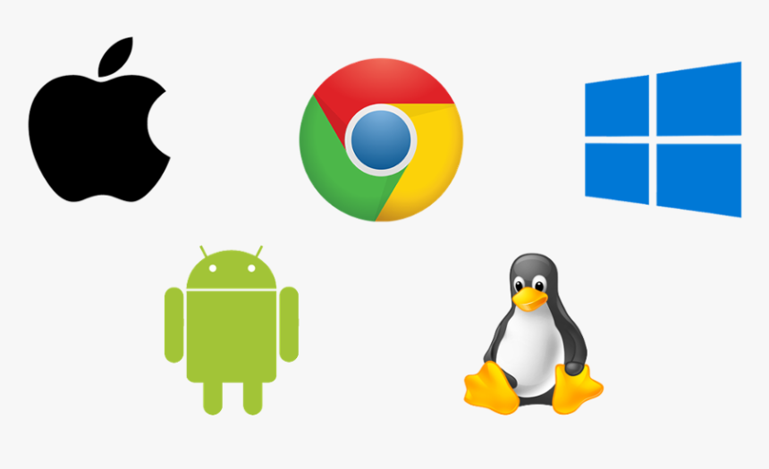
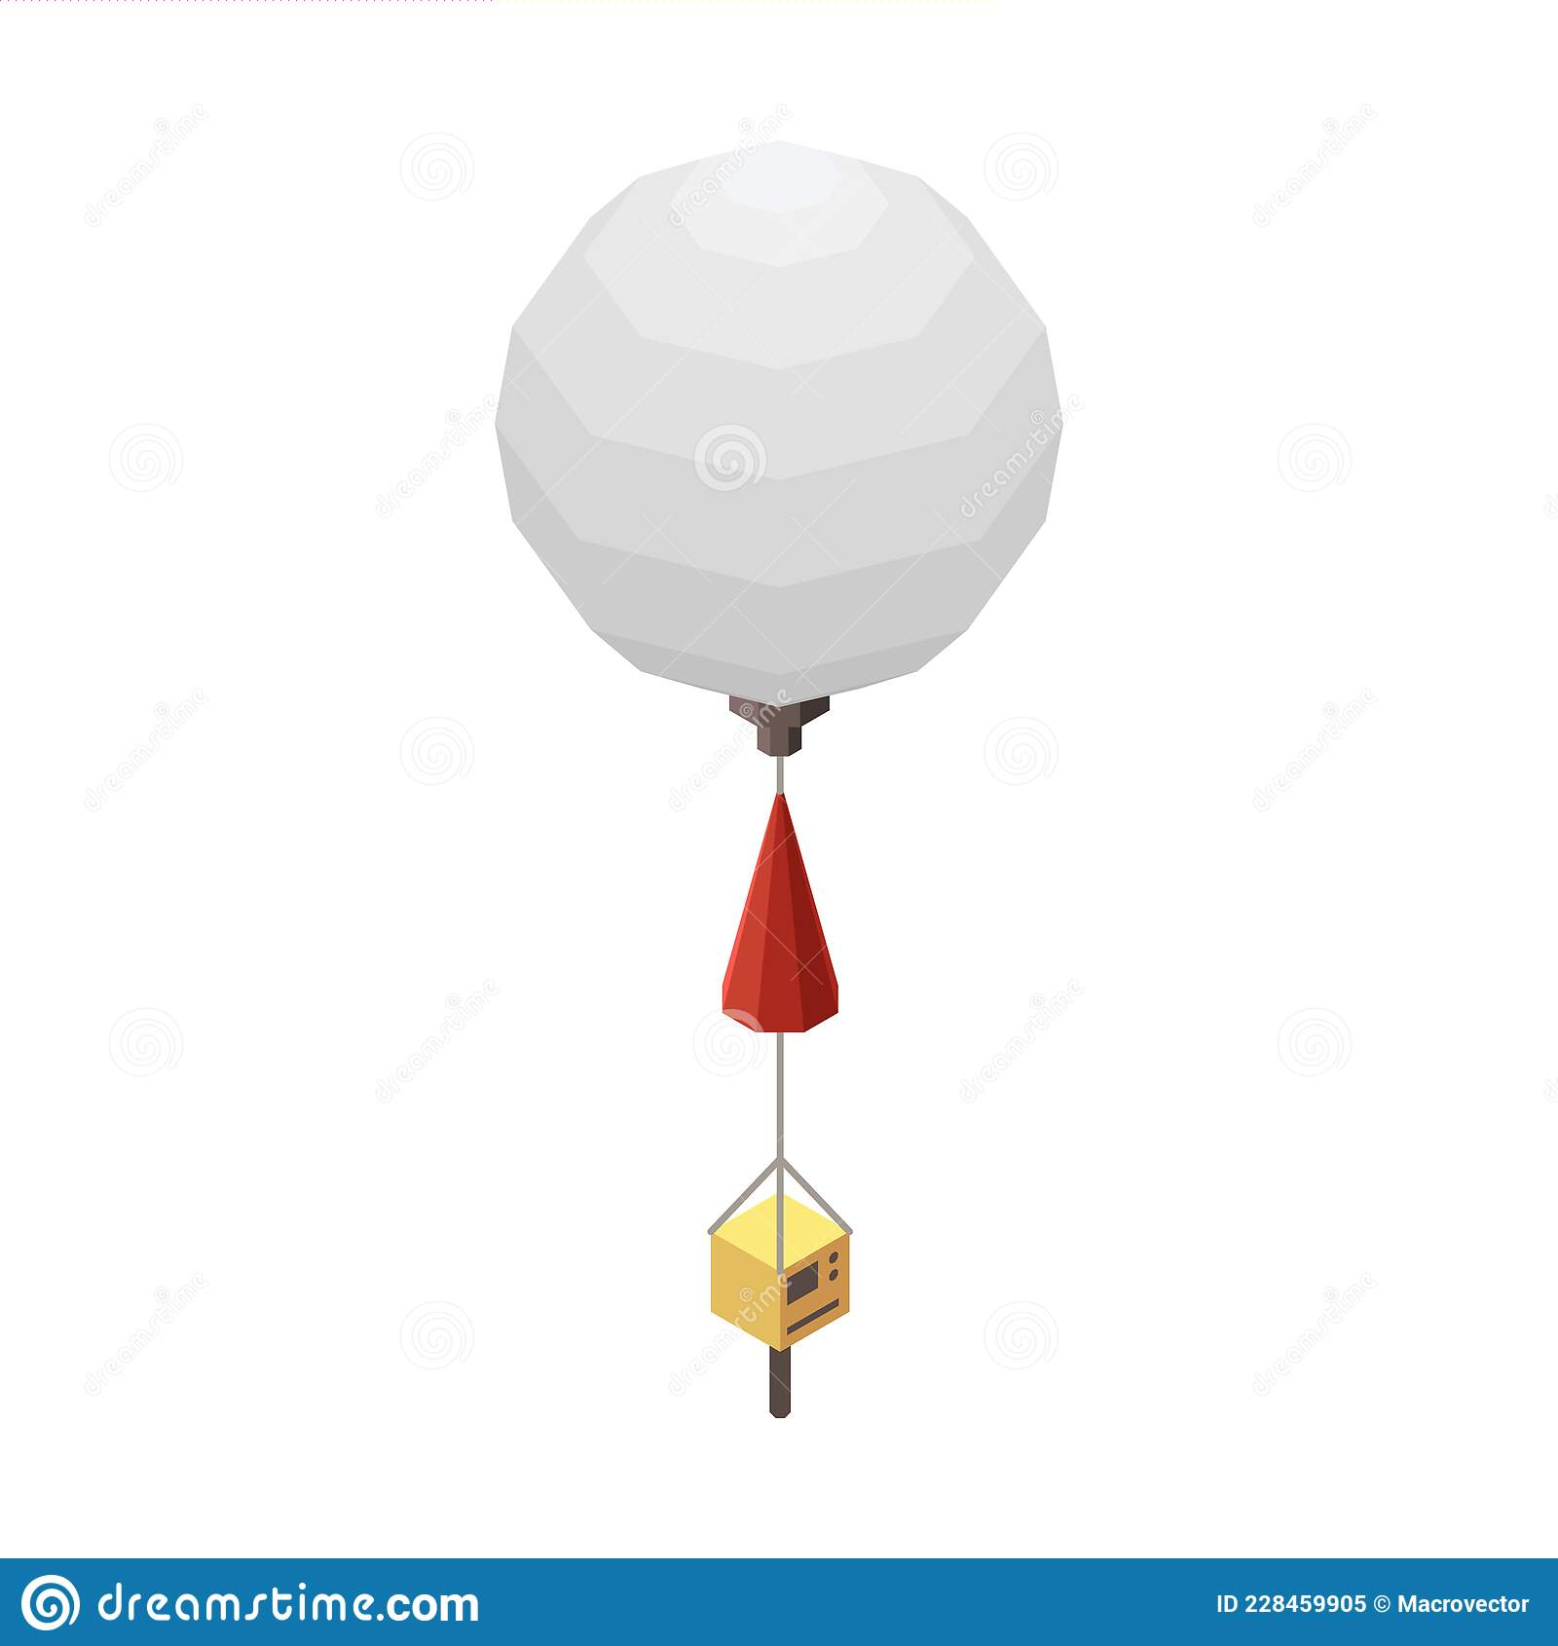

Building the Front End
Usage is for Non-Computer Science Researchers in the Field
Code Must Efficiently Input and Process Multiple Files
"Machine Independence" and Sufficient Documentation for Anyone to Build and Run Code

Slide 8
Tenets of Software Engineering
Low-Level and High-Level Documentation
Don’t Keep Massive Project in 1 File
Coupling
Making Interactions between Distinct Pieces of Code Minimal
Cohesion and Objects
Using Classes /Functions to Combine and "Protect" Similar Data and Functionality

Slide 9
File Access and Management
Accessing Files Via a Program
Absolute vs Relative Paths
OS Dependent File Delimiters
Pathlib Utilities for Hardcoding File Paths
Dealing with and Processing Large Batches of Files
Using Tkinter's Filedialog for Getting File / Folder from User
Class for Holding File's Data

Slide 10
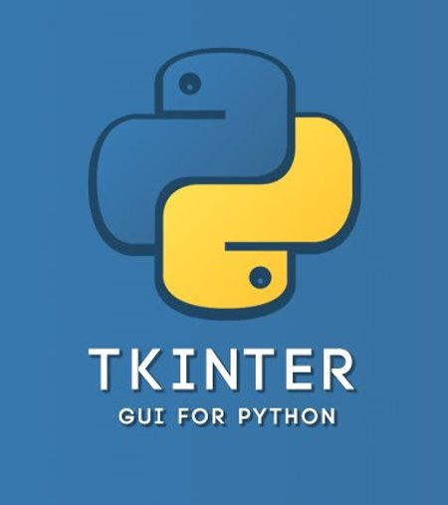
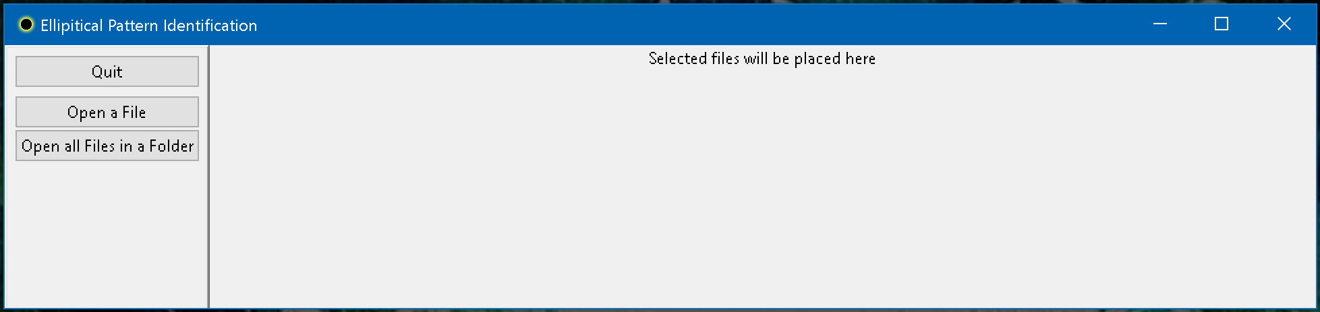
Graphical User Interface
Concise, While Unambiguously Implementing Functionality
Efficient Application of Algorithms to Multiple Files via Proper Software Engineering
Tkinter Toolkit for Implimenting GUI

Slide 11
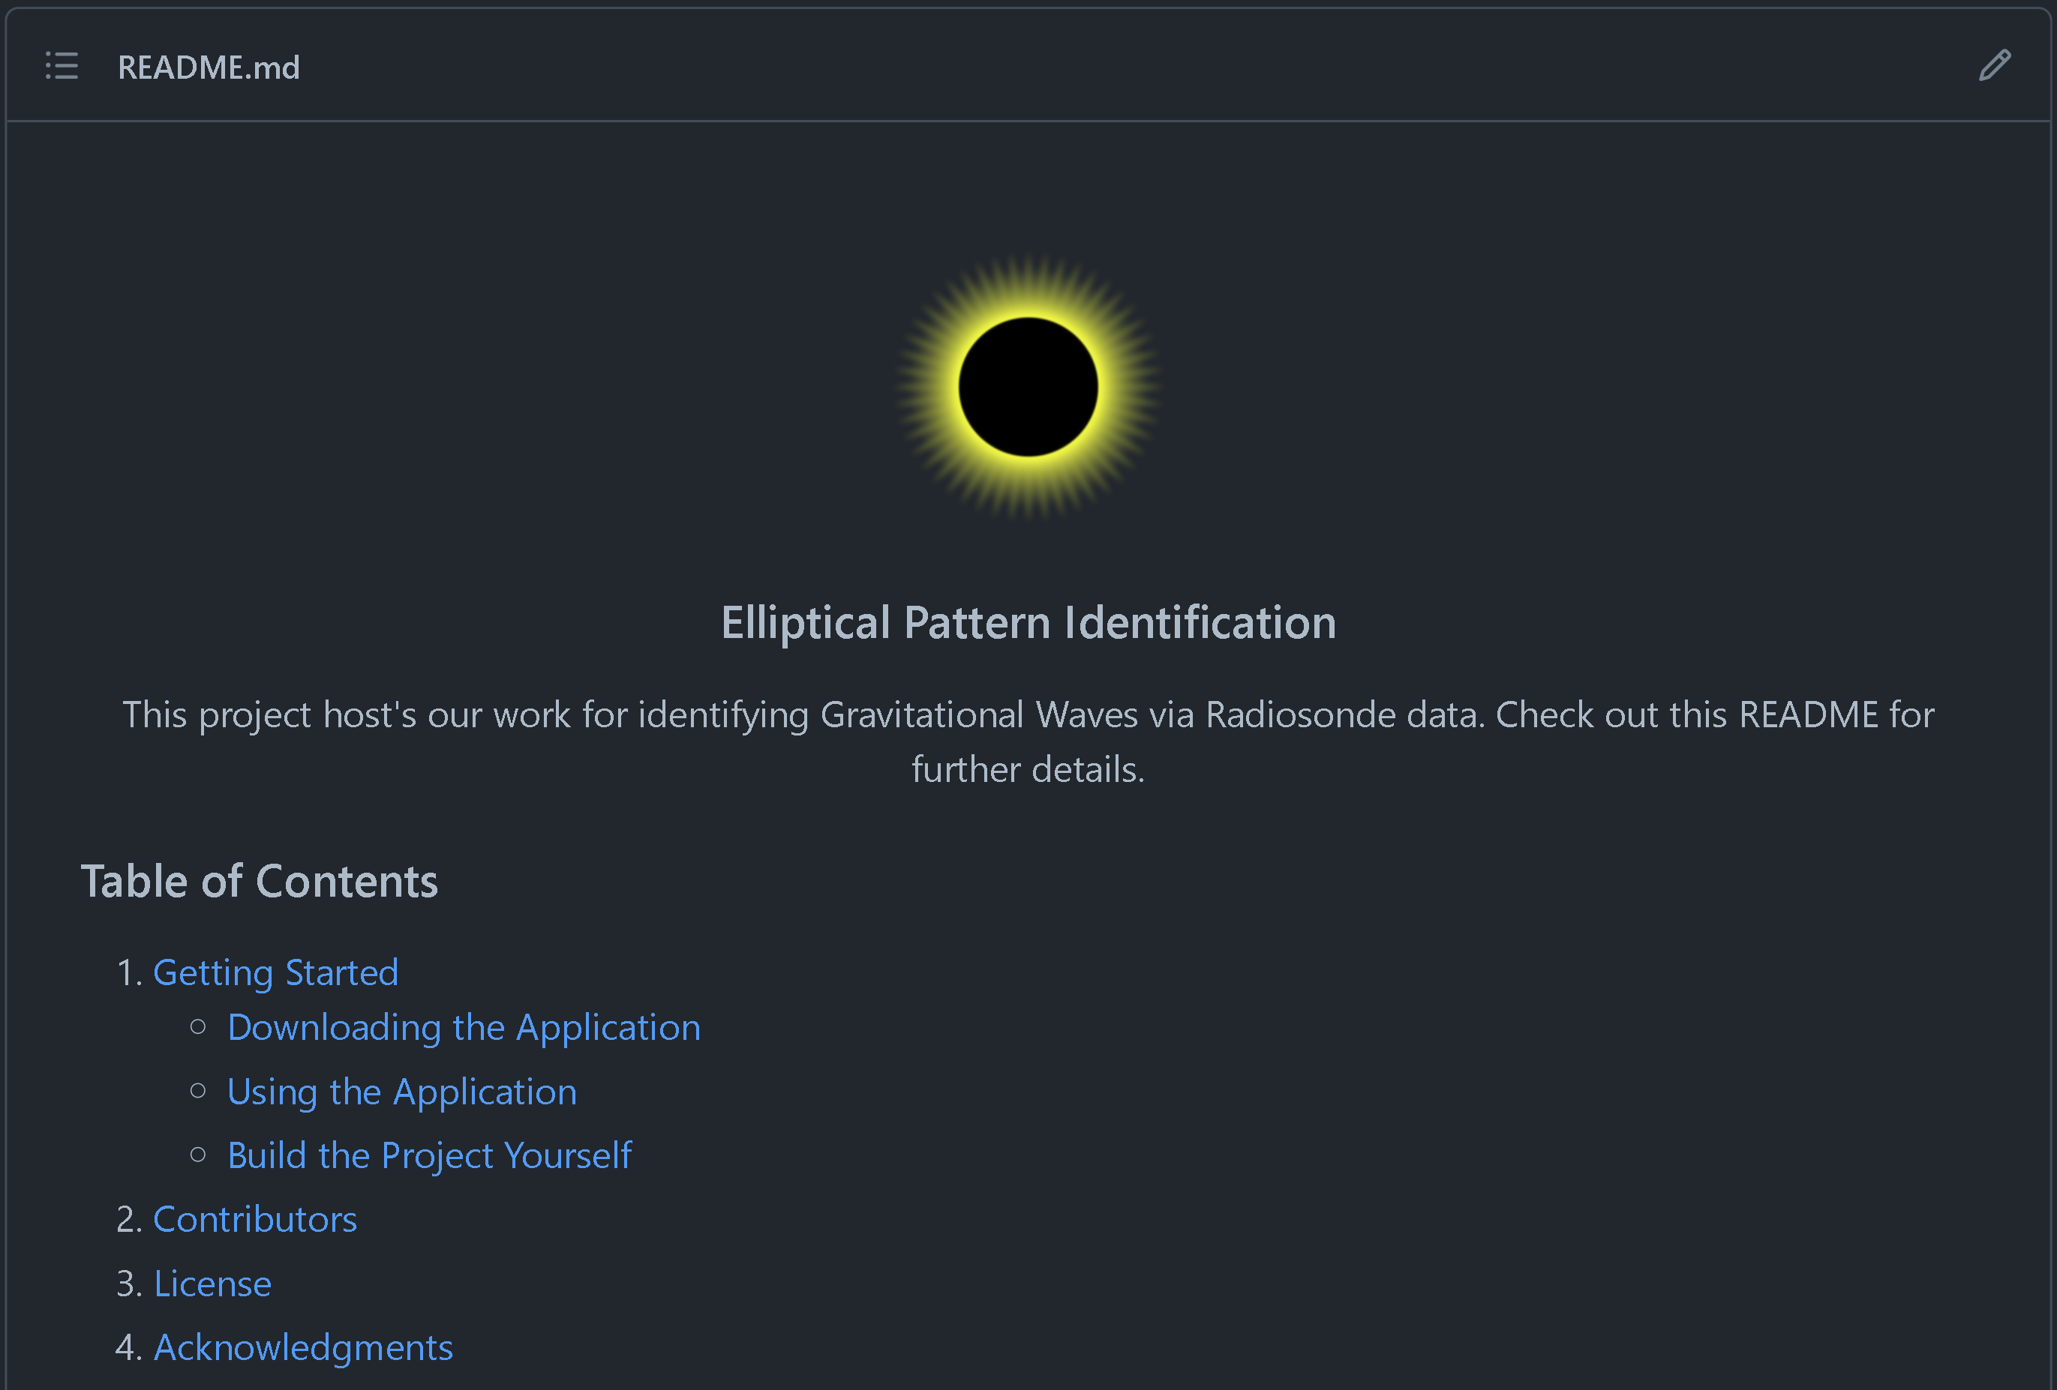
GitHub Repository and Documentation
Scalability of Code and Necessity of High-Level Documentation
GitHub Best Practice and Repository Structure
Sufficient Information to Guide Researchers when Questions Occur

Slide 12



Future Implementation Plans
Restructure, Document, and Utilize Prior Written Code
Matplotlib Data Visualization
Connect to Backend API
Ensure Machine and OS Independence
Define Formatting Conventions for Flight Data

Slide 13
Project Code base restructuring
Current :
Separated file into multiple files
Structured project using object oriented paradigm to allow for easier batch processing
Removed most hard coded elements from script
Removed some of the deprecated code and redundant comments
Going forward:
Set appropriate scope for each objects member variables and methods
Remove all obsolete code and comments
Incorporate source with graphical interface
Make the program more dynamic and allow for greater user controls

Slide 14
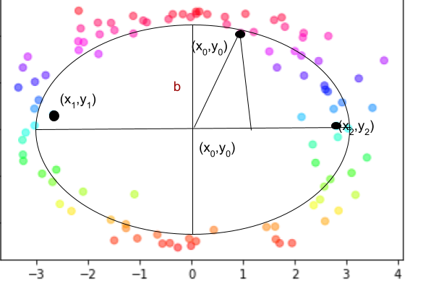
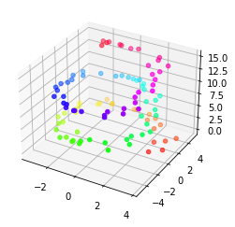
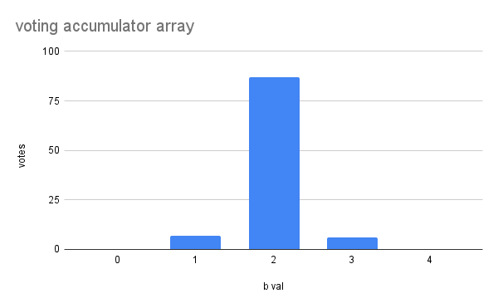
The algorithm
Low Resolution Hough Transform to filter potential ellipse candidates.
1. store points in array and clear accumulator array
2. for each point select as (x1, y2):
3. for each other point (x2, y2) if distance is greater than minimum required continue
4. For each pair points calculate ellipse parameters ie center, major axis length and angle of rotation
5. select third point and if valid candidate continue
6. calculate length of minor axis using third point
7. increment the accumulator for this length by one point
8. loop through remaining candidate pixels
9. Find maximum element in array if votes high enough continue
10. add ellipse parameters to ellipse candidate list
11. Clear accumulator array
12. Loop until set of all point pairs calculated

Slide 15
Review
Value Proposition
Project Objective
Background
Front End Design
Building the Front End
Tenets of Software Engineering
File Management
Graphical User Interface (GUI)
Documentation
Future Plans
Back End Design
Code Base Reconstruction
The Algorithm
Review

